Slide 1
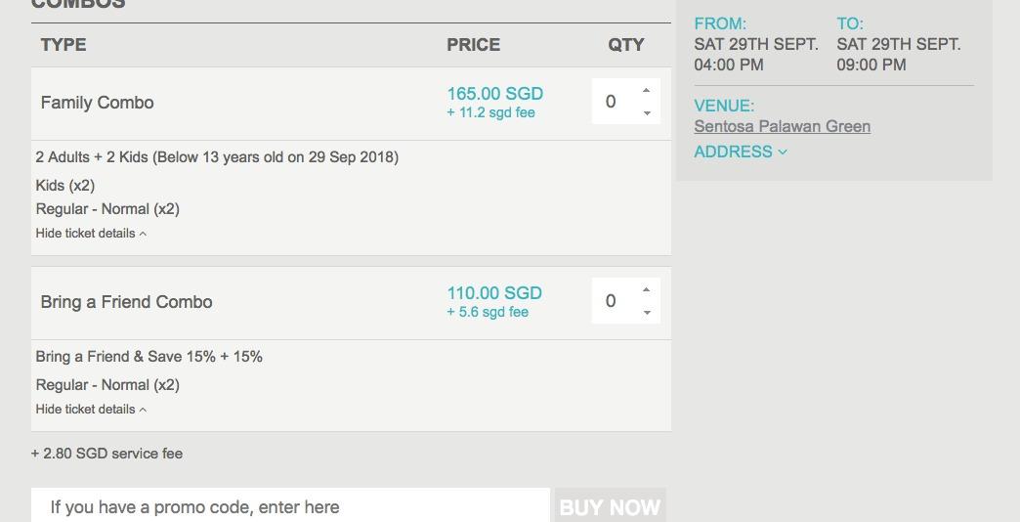
Screenshot - TicketFlap
Change Bring a friend to BFF Combo
Start Friday 3pm
Till Monday 10am
+New Combo
Teachers Day Combo - Total price $130
2 Adults + 1 Kid (Free - Below 13 years old on 29 Sep 2018)
Kids (x1)
Regular – Normal (x2)
Start Friday 3pm
Till Sunday Midnight
Can we make this all live & Test at 12nn?

